Slide 1
Topics: Multiple Regression Analysis (MRA)
Review Simple Regression Analysis
Multiple Regression Analysis
  Design requirements
  Multiple regression model
  R²
  Testing R² and b’s
  Comparing models
  Comparing standardized regression coefficients

Slide 2
Multiple Regression Analysis (MRA)
Method for studying the relationship between a dependent variable and two or more independent variables.
Purposes:
  Prediction
  Explanation
  Theory building

Slide 3
Design Requirements
One dependent variable (criterion)
Two or more independent variables (predictor variables).
Sample size: >= 50 (at least 10 times as many cases as independent variables)

Slide 4
Assumptions
Independence: the scores of any particular subject are independent of the scores of all other subjects
Normality: in the population, the scores on the dependent variable are normally distributed for each of the possible combinations of the level of the X variables; each of the variables is normally distributed
Homoscedasticity: in the population, the variances of the dependent variable for each of the possible combinations of the levels of the X variables are equal.
Linearity: In the population, the relation between the dependent variable and the independent variable is linear when all the other independent variables are held constant.

Slide 5
Simple vs. Multiple Regression
One dependent variable Y predicted from one independent variable X
One regression coefficient
r²: proportion of variation in dependent variable Y predictable from X
One dependent variable Y predicted from a set of independent variables (X1, X2 ….Xk)
One regression coefficient for each independent variable
R²: proportion of variation in dependent variable Y predictable by set of independent variables (X’s)

Slide 6
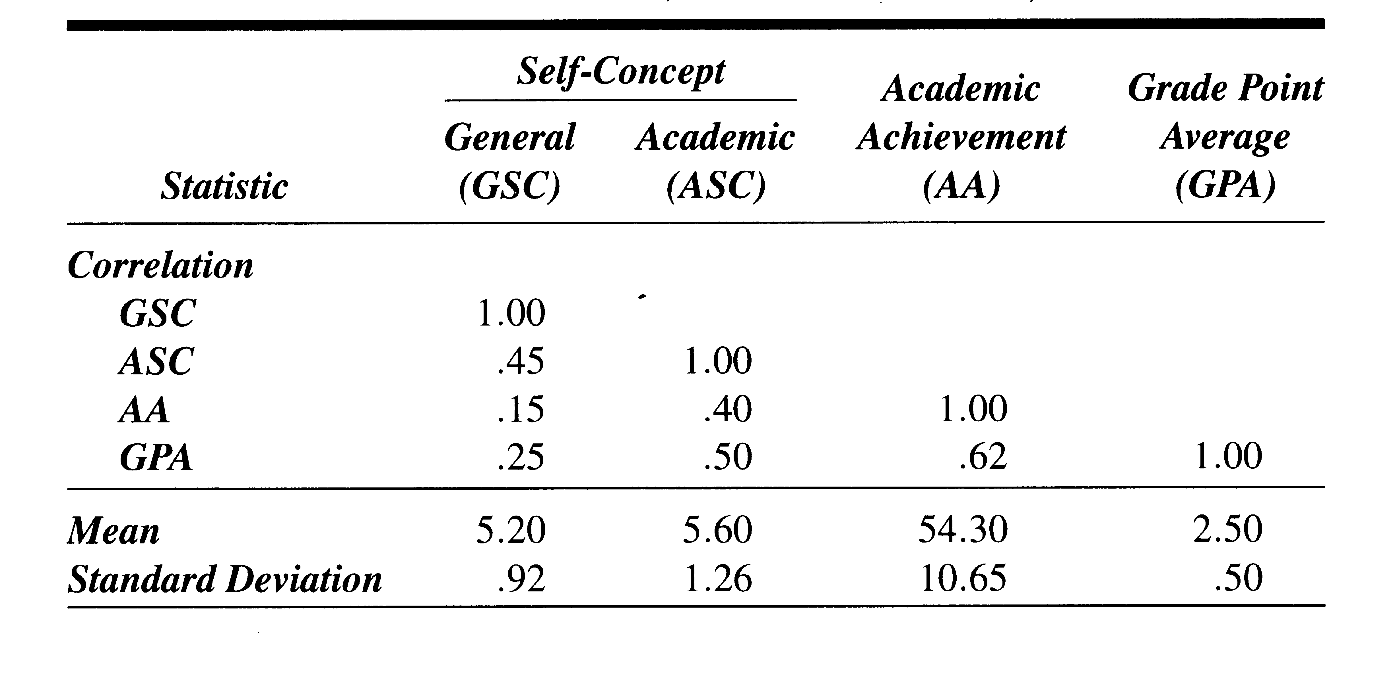
Example: Self Concept and Academic Achievement (N=103)
Notes:
Shavelson, Text example p 530 (Table 18.1) (Example 18.1 p 538)
A study of the relation between academic achievement (AA), grades, and general and academic self concept.
General Self concept- one’s perception of him/her self.
Multifaceted: perception of behavior is the base moving to inferences about self in sub-areas (e.g. physical (appearance, ability), academic (math, history) , social , and then to inferences about self in non-academic and academic areas and then to inferences about self in general.
Academic self concept: one’s perception of self in academic areas
The theory leads us to predict that AA and ASC will be more closely related than AA and GSC, But relationship of grades and these other variables is not so clear
Grades certainly reflect academic achievment, but also student’s efforts, improvement and participation. So hypothesize that best predictor of grades might be AA and GSC. Once AA and GSC have been used to predict grades, academic self-concept not expected to improve the prediction of grades (I.e. ASC not expected to account for any additional variation in grades.
MRA allows us to statistically examine these predictions from self-concept theory.

Slide 7
Example: The Model
Y’ = a + b₁X₁ + b₂X₂ + …b_{k}X_{k}
The b’s are called partial regression coefficients
Our example-Predicting AA:
  Y’= 36.83 + (3.52)X_{ASC} + (-.44)X_{GSC}
Predicted AA for person with GSC of 4 and ASC of 6
  Y’= 36.83 + (3.52)(6) + (-.44)(4) = 56.23

Slide 8
Multiple Correlation Coefficient (R) and Coefficient of Multiple Determination (R²⁾
R = the magnitude of the relationship between the dependent variable and the best linear combination of the predictor variables
R² = the proportion of variation in Y accounted for by the set of independent variables (X’s).

Slide 9
Explaining Variation: How much?
Predictable variation by the combination of independent variables
Total Variation in Y
Unpredictable
Variation
Notes:
Total variance:
Predicted (Explained) Variance (SS Regression):
Coefficient of Determination (R2) = predictable variation by the combination of independent variables
Unpredicted (Residual) Variance (SS Residual):
SSreg/SSy = proporion of variation in Y predictable from X’s (R2)
SSres/SSy = proportion of variaion in Y unpredictable from X’s (1-R2)
In our example: R = .41 and R2 = .161 (16% of the variability in academic achievement is accouted for by the weighted composite of the independent variables general and academic self-concept (actually the formula for computing R2 is used first, then take the squareroot of R2)

Slide 10
Proportion of Predictable and Unpredictable Variation
(1-R²) = Unpredictable (unexplained) variation in Y
Where:
Y= AA
X₁ = ASC
X₂ =GSC
Y
X₁
R2 = Predictable (explained) variation in Y
X₂

Slide 11
Various Significance Tests
Testing R²
  Test R² through an F test
  Test of competing models (difference between R²) through an F test of difference of R²s
Testing b
  Test of each partial regression coefficient (b) by t-tests
  Comparison of partial regression coefficients with each other - t-test of difference between standardized partial regression coefficients (β)

Slide 12
Example: Testing R²
What proportion of variation in AA can be predicted from GSC and ASC?
  Compute R²: R² = .16 (R = .41) : 16% of the variance in AA can be accounted for by the composite of GSC and ASC
Is R² statistically significant from 0?
  F test: F_{observed} = 9.52, F_{crit (05/2,100)} = 3.09
  Reject H₀: in the population there is a significant relationship between AA and the linear composite of GSC and ASC

Slide 13
Example: Comparing Models -Testing R²
Comparing models
  Model 1: Y’= 35.37 + (3.38)X_{ASC}
  Model 2: Y’= 36.83 + (3.52)X_{ASC} + (-.44)X_{GSC}
Compute R² for each model
  Model 1: R² = r² = .160
  Model 2: R² = .161
Test difference between R²s
  F_{obs} = .119, F_{crit(.05/1,100)} = 3.94
  Conclude that GSC does not add significantly to ASC in predicting AA

Slide 14
Testing Significance of b’s
H0: β = 0
t_{observed} = b - β
standard error of b
with N-k-1 df

Slide 15
Example: t-test of b
t_{observed} = -.44 - 0/14.24
t_{observed} = -.03
t_{critical(.05,2,100)} = 1.97
Decision: Cannot reject the null hypothesis.
Conclusion: The population β for GSC is not significantly different from 0

Slide 16
Comparing Partial Regression Coefficients
Which is the stronger predictor? Comparing b_{GSC} and b_{ASC}
Convert to standardized partial regression coefficients (beta weights, β’s)
  β_{GSC} = -.038
  β_{ASC} = .417
  On same scale so can compare: ASC is stronger predictor than GSC
Beta weights (β’s ) can also be tested for significance with t tests.

Slide 17
Different Ways of Building Regression Models
Simultaneous: all independent variables entered together
Stepwise: independent variables entered according to some order
  By size or correlation with dependent variable
  In order of significance
Hierarchical: independent variables entered in stages

Slide 18
Practice:
Grades reflect academic achievement, but also student’s efforts, improvement, participation, etc. Thus hypothesize that best predictor of grades might be academic achievement and general self concept. Once AA and GSC have been used to predict grades, academic self-concept (ASC) is not expected to improve the prediction of grades (I.e. not expected to account for any additional variation in grades)

